Slide 1


Group analyses
Will Penny
Wellcome Dept. of Imaging Neuroscience
University College London

Slide 2
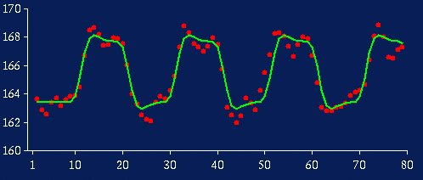
Subject 1
For voxel v in the brain
Effect size, c ~ 4

Slide 3
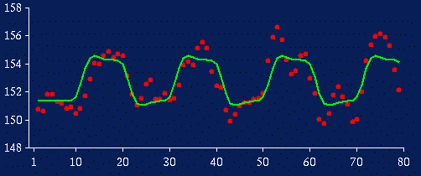
Subject 3
For voxel v in the brain
Effect size, c ~ 2

Slide 4
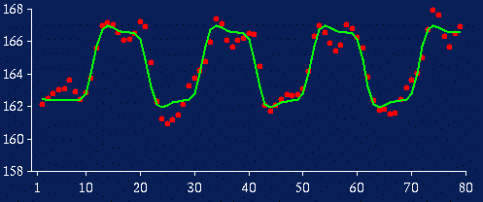
Subject 12
For voxel v in the brain
Effect size, c ~ 4

Slide 5
Whole Group
For group of N=12 subjects effect sizes are
c = [4, 3, 2, 1, 1, 2, 3, 3, 3, 2, 4, 4]
Group effect (mean), m=2.67
Between subject variability (stand dev), s_{b} =1.07
Standard Error Mean (SEM) = s_{b} /sqrt(N)=0.31
Is effect significant at voxel v?
t=m/SEM=8.61
p=10⁻⁶

Slide 6
Random Effects Analysis
For group of N=12 subjects effect sizes are
c= [3, 4, 2, 1, 1, 2, 3, 3, 3, 2, 4, 4]
Group effect (mean), m=2.67
Between subject variability (stand dev), s_{b} =1.07
This is called a Random Effects Analysis (RFX) because we are comparing the group effect to the between-subject variability.

Slide 7
Summary Statistic Approach
For group of N=12 subjects effect sizes are
c = [3, 4, 2, 1, 1, 2, 3, 3, 3, 2, 4, 4]
Group effect (mean), m=2.67
Between subject variability (stand dev), s_{b} =1.07
This is also known as a summary statistic approach because we are summarising the response of each subject by a single summary statistic – their effect size.

Slide 8
Subject 1
For voxel v in the brain
Effect size, c ~ 4
Within subject variability, s_{w}~0.9

Slide 9
Subject 3
For voxel v in the brain
Effect size, c ~ 2
Within subject variability, s_{w}~1.5

Slide 10
Subject 12
For voxel v in the brain
Effect size, c ~ 4
Within subject variability, s_{w}~1.1

Slide 11
Fixed Effects Analysis
Time series are effectively concatenated – as though we had one subject with N=50x12=600 scans.
s_{w} = [0.9, 1.2, 1.5, 0.5, 0.4, 0.7, 0.8, 2.1, 1.8, 0.8, 0.7, 1.1]
Mean effect, m=2.67
Average within subject variability (stand dev), s_{w} =1.04
Standard Error Mean (SEM_{W}) = s_{w} /sqrt(N)=0.04
Is effect significant at voxel v?
t=m/SEM_{W}=62.7
p=10⁻⁵¹

Slide 12
RFX versus FFX
With Fixed Effects Analysis (FFX) we compare the group effect to the within-subject variability. It is not an inference about the sample from which the subjects were drawn.
With Random Effects Analysis (RFX) we compare the group effect to the between-subject variability. It is an inference about the sample from which the subjects were drawn. If you had a new subject from that population, you could be confident they would also show the effect.
A Mixed Effects Analysis (MFX) has some random and some fixed effects.

Slide 13
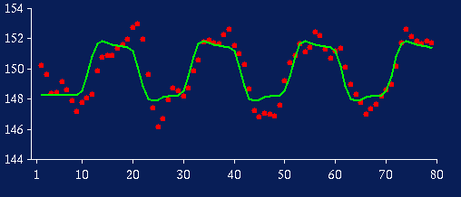
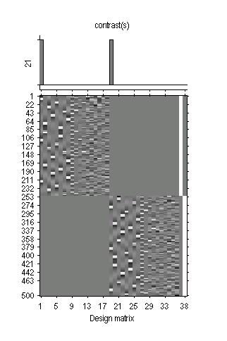
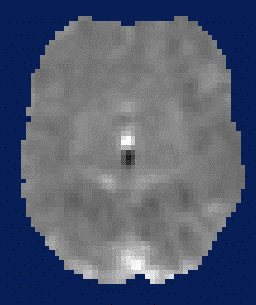
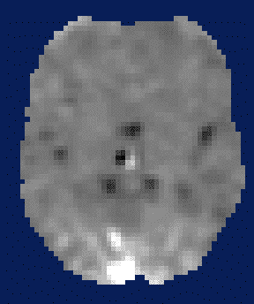
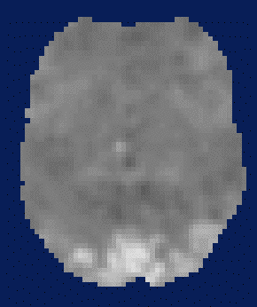
RFX: Summary Statistic
First level
Data Design Matrix Contrast Images

Slide 14
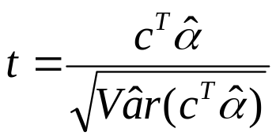
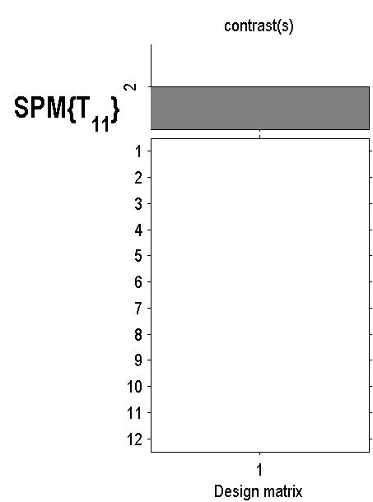
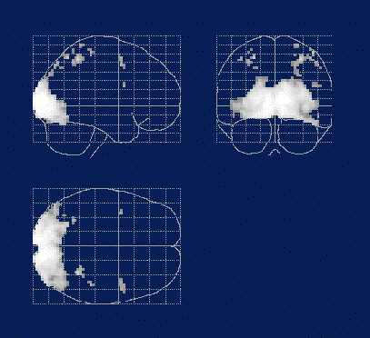
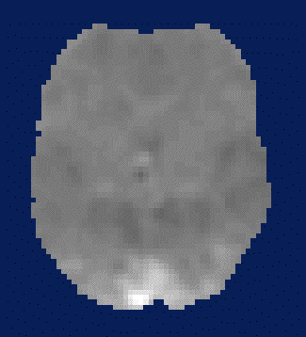
RFX: Summary Statistic
First level
Second level
Data Design Matrix Contrast Images
SPM(t)
One-sample
t-test @ 2nd level

Slide 15
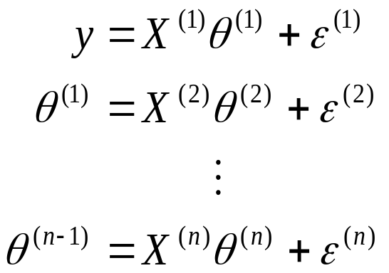
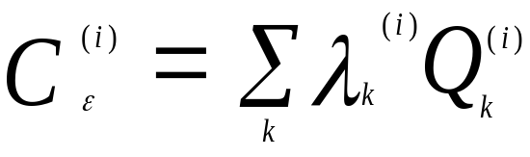
RFX: Hierarchical model
Hierarchical model
Multiple variance components at each level
At each level, distribution of parameters is given by level above.
What we don’t know: distribution of parameters and variance parameters.

Slide 16
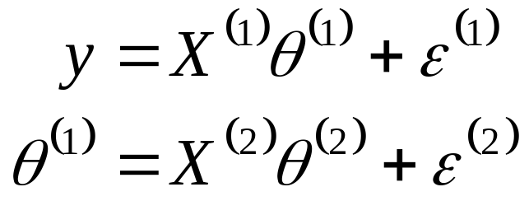


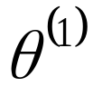



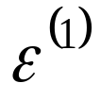

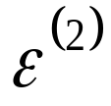


RFX: Hierarchical Model
(1) Within subject variance, s_{w}(i)
(2) Between subject variance,s_{b}
=
+
=
+
Second level
First level

Slide 17
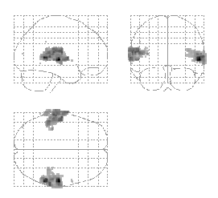

RFX:Auditory Data
Summary
statistics
Hierarchical
Model
Friston et al. (2004) Mixed effects and fMRI studies, Neuroimage

Slide 18
RFX: SS versus Hierarchical
The summary stats approach is exact if for each session/subject:
Within-subject variances the same
First-level design (eg number of trials) the same
Other cases: Summary stats approach is robust against typical violations (SPM book 2006 , Mumford and Nichols, NI, 2009).
Might use a hierarchical model in epilepsy research where number of seizures is not under experimental control and is highly variable over subjects.

Slide 19
Multiple Conditions
Condition 1 Condition 2 Condition3
Sub1 Sub13 Sub25
Sub2 Sub14 Sub26
... ... ...
Sub12 Sub24 Sub36
ANOVA at second level (eg drug). If you have two conditions this is a two-sample t-test.

Slide 20
Multiple Conditions
Condition 1 Condition 2 Condition3
Sub1 Sub1 Sub1
Sub2 Sub2 Sub2
... ... ...
Sub12 Sub12 Sub12
ANOVA within subjects at second level.
This is an ANOVA but with average subject effects removed. If you have two conditions this is a paired t-test.

Slide 21
Summary
Group Inference usually proceeds with RFX analysis, not FFX. Group effects are compared to between rather than within subject variability.
Hierarchical models provide a gold-standard for RFX analysis but are computationally intensive (spm_mfx).
Summary statistics are a robust method for RFX group analysis (SPM book, Mumford and Nichols, NI, 2009)
Can also use ‘ANOVA’ or ‘ANOVA within subject’ at second level for inference about multiple experimental conditions..

